Slide 1
INFORMATION VISULAISATION PROJECT
REVIEW-2

Slide 2
TEAM MEMBERS
TEAM NUMBER 7
ARYA DADHICH 19MIA1025
UDBHAV NEMMANI 19MIA1041
HARSHINI K. AIYYER 19MIA1050
GAURAV TRIVEDI 19MIA1077

Slide 3
MOTIVATION
Consider a firm owing multiple branches across a country. The firm decides to analyze its customer in order to find most suitable place to open a new branch and understand the customer behavior. It will not only help in aiming maximum profit but the firm can serve the customers in more efficient ways.

Slide 4
DATA INFORMATION & DEPENDENCIES
This dataset composes of below 7 features:
CustomerID: Unique ID assigned.
Gender
City: City, where customer lives
Age
Annual Income
Credit Score: Amount of credit firm can give to a particular customer
Spending Score(1-100): Score assigned by the mall based on customer behaviour and spending nature.
Library Used:
Numpy|Pandas: Will help us treat and explore the data, and execute vector and matrix operations.
Matplotlib|seaborn: Will help us plot the information so we can visualize it in different ways and have a better understanding of it.
Plotly: Will also help us plotting data in a fancy way.
Sklearn: Will provide all necessary tools to train our models and test them afterwards.

Slide 5
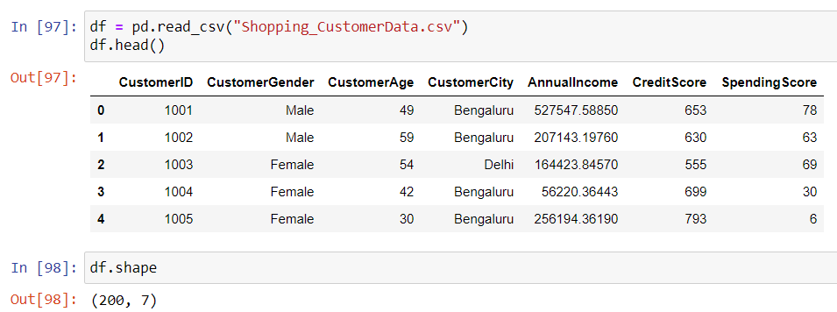
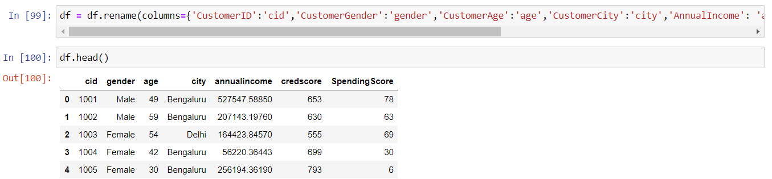
DATA EXPLORATION
In this section we are doing a little bit of data exploration, checking for null values, object data types and other things we might consider in order to keep our data clean and well structured.
As you can see, column names are quite complex. So we will be renaming them to simpler names, to make the dataset more accessible.

Slide 6
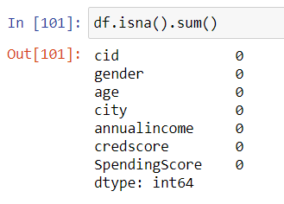
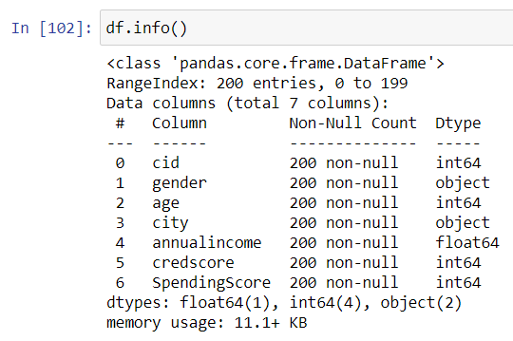
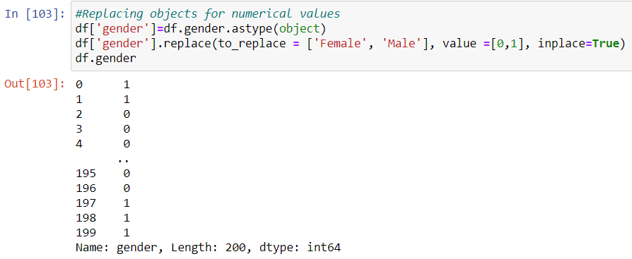
DATA EXPLORATION
Checking for null values in Dataset.
Understanding dataset in a better way by identifying datatypes of all variables.
As you can see, Gender is non numeric. We might face complexities while visualizing gender. So, we will convert gender to numeric data as Male=0, Female =1

Slide 7
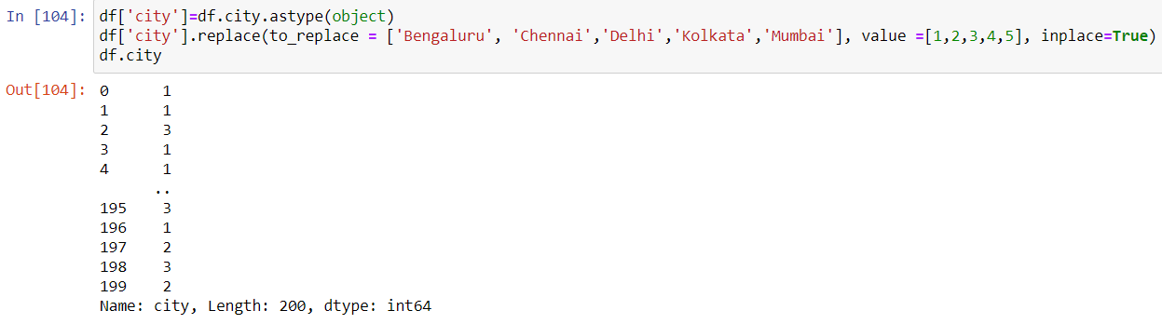
DATA EXPLORATION
As we saw in previous slide, City is also non numeric. So, we will convert City to numeric data as Bengaluru=1, Chennai=2, Delhi=3, Kolkata=4, Mumbai=5

Slide 8
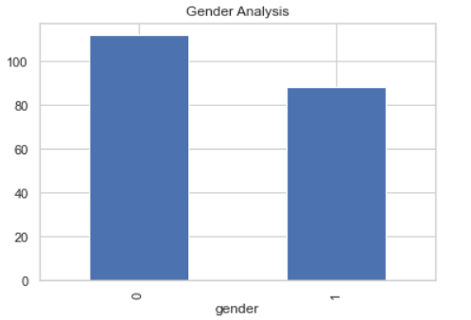
GENDER ANALYSIS
Gender is the major factor out of all the other factors that affects consumer purchasing behavior. When gender differs, the perception of consuming the product is different as well. Men and women tend to have different choices while shopping because of the difference in their upbringing and socialization.
Notes:
After reading out the slide, talk about how gender analysis in consumer behavior is in this particular dataset. IN SHORT talk about graph.

Slide 9
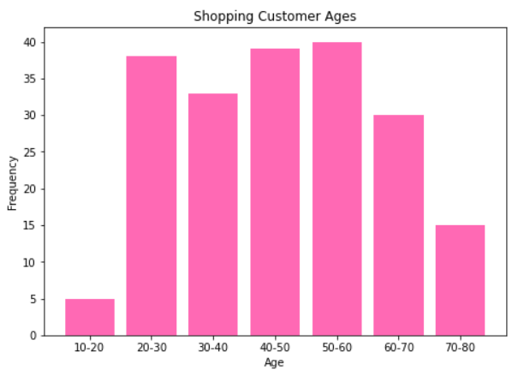
AGE ANALYSIS
Age is an important demographic factor that affects consumer behavior. As people grow, their needs change. Similar changes come to their buying decision making patterns. Age does not just affect buying behavior, it is also an important factor affecting market segmentation and marketing strategy.
Notes:
Talk about graph, don’t read out the slide only.

Slide 10
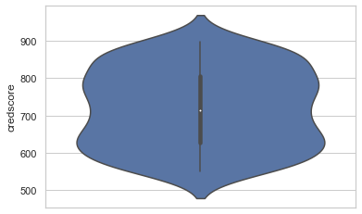
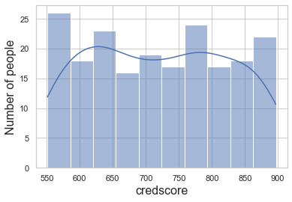
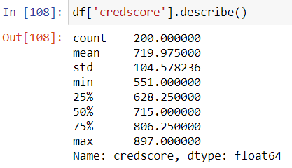
CREDIT SCORE ANALYSIS
Credit scoring is the technique that help organizations or firms decide whether or not to grant credit to consumers who apply to them.
Credscore Description:
Violin Plot:
No. of people v/s Credscore:

Slide 11
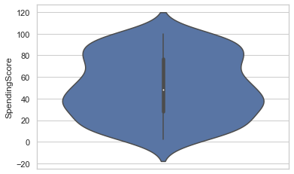
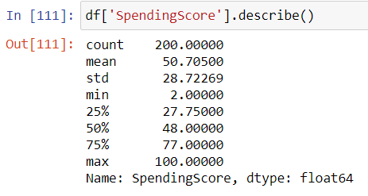
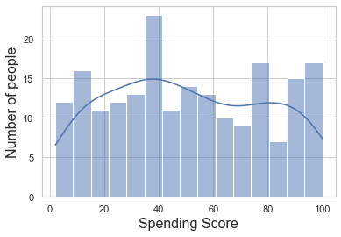
SPENDING SCORE ANALYSIS
Spending score is something that is assigned by the Mall to customers based on the buying and purchasing behavior.
Spending Score Description:
Violin plot:
No. of people v/s Spending Score:

Slide 12
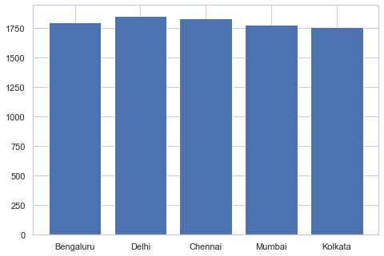
CITY ANALYSIS
Some facets of the evolution of consumer shopping behavior are examined by a comparison in regions of differing economic development.
No. of customers in each city:
Bengaluru: 50
Chennai: 45
Delhi: 37
Mumbai: 39
Kolkata: 29
Notes:
Talk about graph

Slide 13
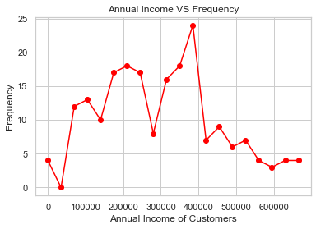
ANNUAL INCOME ANALYSIS
Income has the ability to influence the buying behavior of a person. Higher income gives higher purchasing power to consumers. When a consumer has higher disposable income, it gives more opportunity for the consumer to spend on luxurious products.
Notes:
Explain graph

Slide 14
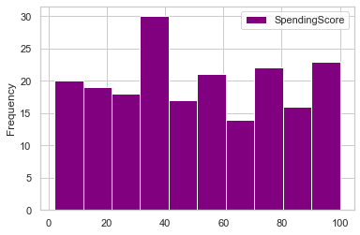
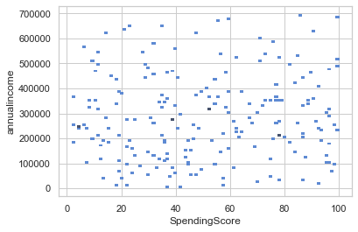
SPENDING SCORE V/S ANNUAL INCOME

Slide 15
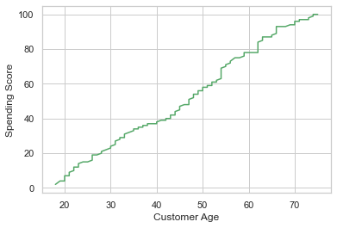
AGE V/S SPENDING SCORE
In order to understand the relationship between the age of the customer and the spending score, we plotted a graph to verify the same. The spending score is increasing with the age, the possible reasons could be:
According to the duration of years of purchasing from the store.
The score is for one account , i.e, there could be too many people using the card while shopping to avail the score.

Slide 16
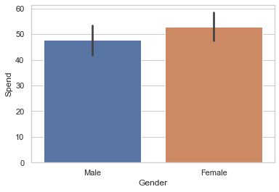
GENDER V/S SPENDING SCORE
We need to find the relation between gender and spending score.
According to this dataset, the number of females have a slightly higher spending score than the male customers. This means that the female customers spend more than the male customers for this company.

Slide 17
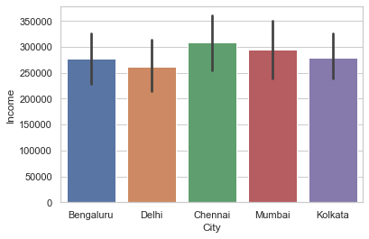
CITY V/S ANNUAL INCOME
It is observed that Chennai city has people with higher annual income, followed by Mumbai, Kolkata, Bengaluru, Delhi.

Slide 18
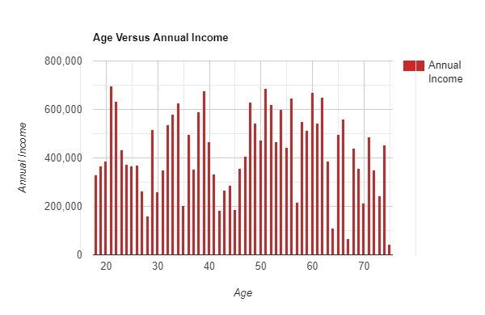
AGE V/S ANNUAL INCOME
As we mature and gain work experience, our incomes tend to rise; income typically peaks when we near retirement.

Slide 19
THANK YOU!

